Slide 1

CHE-2410-Project #1
Titled: Analyzing Corrosion Rate % in Carbon steel Pipelines Considering the Gas Flowrate and Water Cut %
Presented by: Ahmed Jabbari
November 2,2023

Slide 2
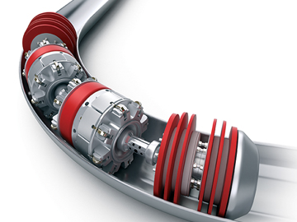
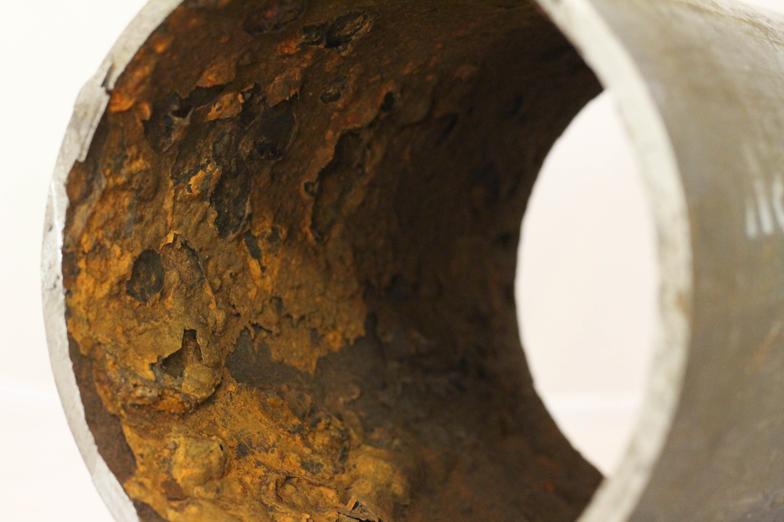
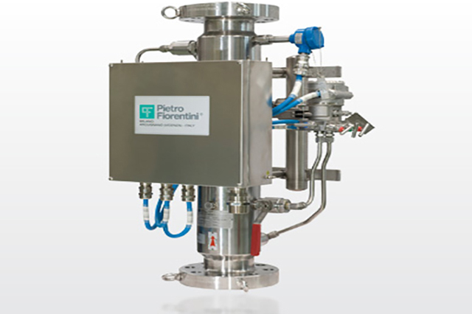
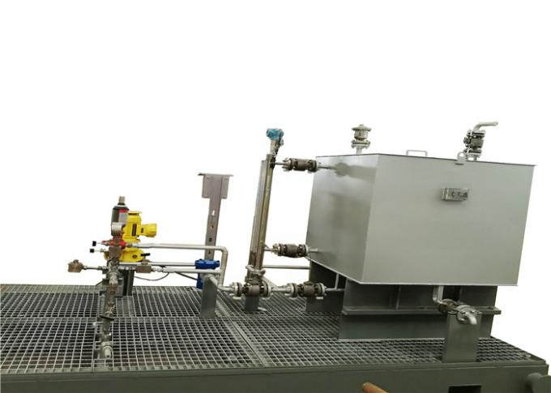
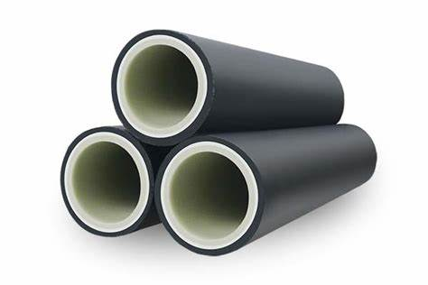
Background
Conclusion
Analysis 1
Analysis 2
Corrosion is one of main challenges in the oil and gas industry.
Expensive controlling methods, consume
up to 20% of the operating cost.
There are huge ongoing efforts such as
using Reinforced Thermoplastic Pipe (RTP).
Analyzing the corrosion factors (Gas Flowrate and water cut %).
Based on result, suggest a controlling method to minimize/eliminate the corrosion.
Gas Flowrate and water cut % are measured by Multiphase Flow Meter (MFM) and Corrosion Rate is measured by in-line instrument scraper.
Drivers
Methods

Slide 3
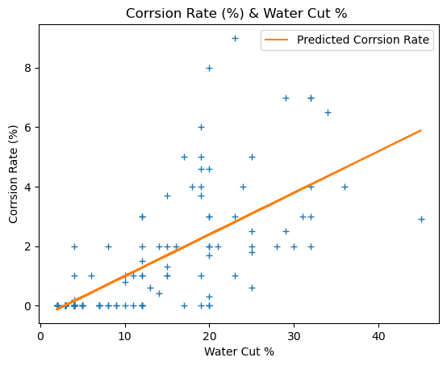
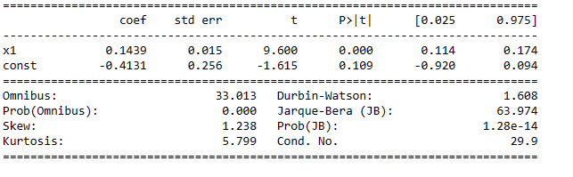
Background
Conclusion
Analysis 1
Analysis 2
Individual Analysis:
Corrosion Rate % (Y) and the Water Cut % (X1):
I used Python’s OLS linear regression model:
Y=0.14* X1 -0.41:
The p-value for water cut % is
less than 0.05:
There is positive linear relationship:

Slide 4
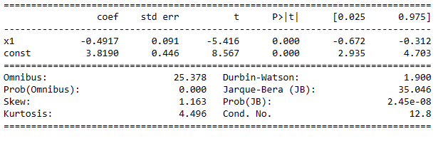
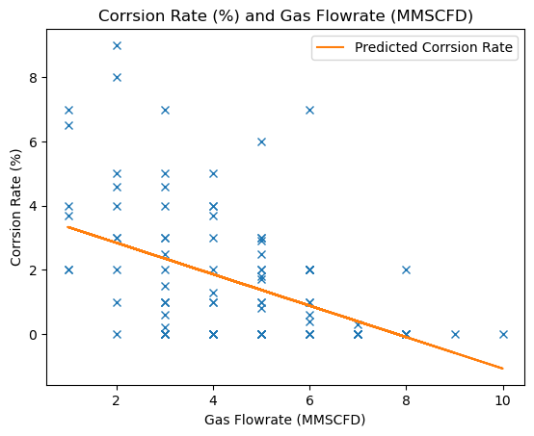
Background
Conclusion
Analysis 1
Analysis 2
Individual Analysis:
Corrosion Rate % (Y) and the Gas Flowrate (X1):
I used Python’s OLS linear regression model:
Y=- 0.14* X1 +3.82:
The p-value for gas flowrate is
less than 0.05:
There is negative linear relationship:

Slide 5
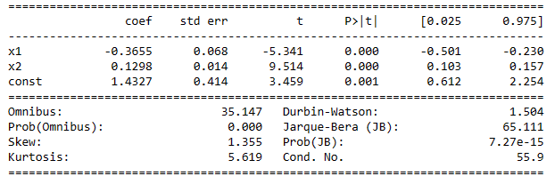
Background
Conclusion
Analysis 1
Analysis 2
Linear models considering
two factors:
I used Python’s OLS linear regression model:
Y=- 0.37* X1+0.13*X2 +1.4:
The p-values are less than 0.05:
There is a linear relationship:
The water cut % has strong effect on corrosion rate :
Water Cut %= 2.81*Flowrate -11 (X2=2.81*X1-11):

Slide 6
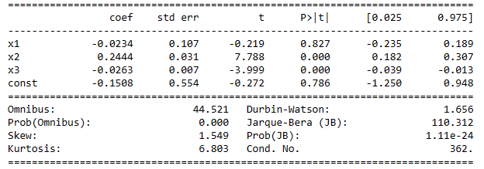
Background
Conclusion
Analysis 1
Analysis 2
Linear models considering two
factors with interactions:
I used Python’s OLS linear regression model:
Y=- 0.023* X1+0.24*X2-0.026*X3 -0.151:
The p-value for X3 is less than 0.05:
There is an interaction between gas flowrate and water cut % :

Slide 7
Background
Conclusion
Analysis 1
Analysis 2
Positive linear relationship
between corrosion rate % and water cut %.
1
Negative linear relationship
between corrosion rate % and gas flowrate.
2
Water cut % has a stronger positive
effect on corrosion rate than
flowrate negative effect.
3
There is an interaction between
gas flowrate and water cut % in
predicting corrosion rate %.
4
5
5
Water Cut %= 2.81*Flowrate -11
E

Slide 8
Background
Conclusion
Analysis 1
Analysis 2
Positive linear relationship
between corrosion rate % and water cut %.
1
Negative linear relationship
between corrosion rate % and gas flowrate.
2
Water cut % has a stronger positive
effect on corrosion rate than
flowrate negative effect.
3
There is an interaction between
gas flowrate and water cut % in
predicting corrosion rate %.
4
5
5
Water Cut %= 2.81*Flowrate -11
E

Slide 9
Thank You
Any Question ?
5

